Slide 1

Light Field Imaging Toolbox

Slide 2
Design goals
Modular
Extensible
Interfaces and implementations
APIs/SPIs... accessible from notebooks or napari
Interoperable
Light Field Imaging (napari plugin)
adapters to ImageJ, ImgLib2, Bioformats,

Slide 3
Modules
design interfaces for the entire workflow, regardless of implemention
LFAcquire (using umgr?, later)
LFMeta, LFData
LFData.import, transform
LFCalibrate
LFRectify
LFDeconvolution
LFDeepLearn, LFInference
LFView… LFDisplay

Slide 4
Modules
LFIplugin
LFGUI
LFDisplay
LFMetadata
tags, types
LFCalibrate
LFData
file organization & structure
import,
convert, transform, rearrange,
export
types: .tif, .h5, …
LFRectify
LFDeepLearn
Training
Inference
LFDeconvolution
LFMNet

Slide 5
Use Cases…
As an application:
As napari plugin:
Launch
as application
Desktop frame
napari
LFI Plugin
LFI Plugin
LFI Gui
For instance,
Use to input
Acquisition parameters
when running experiment
LFI Gui
LFI Gui
Jupyter
Launch from script
LFM Lib
LFMeta, LFData
LFData.import, transform
LFCalibrate
LFRectify
LFDeconvolution
As Library/API
Other application

Slide 6
Data Flow / Workflow
<Sample folder>
Sample.lfm
…
….
RawLFImage.tif
stack
deconvolve
LF metadata, text
JSON
rectify
DarkImage.tif
Perspective
(subaperture)
calibrate
Calibration file
WhiteImage.tif

Slide 7
Functionality
Select Dataset location
(folder or .h5)
Select RawLF(s)
View RawLF(s)
Set Metadata
NA, mag, pitch, …
View Rectified
Quick Deconvolve
View Perspectives
Full Deconvolve
Select White & Dark
Select Output
[as file, as dataset on .h5]
Calibrate
Settings:
Device
3D View of Stack
Set Quick Deconvolve method/params
Inspect Calibration
Set Full Deconvolve method/params

Slide 8
Data and Metadata
Maintain adequate provenance for replication
Comply with existing file and metadata norms
File / dataset naming
Containers / file formats
Metadata
Labels, semantics
LFMeta specify metadata req'd
LFData + utilizes LFMeta
napari handling of metadata?
For remote files…
LFAnalyse uses
SCP file transfer… Windows?

Slide 9
Files
Options for file/data structuring
files in folders
datasets in groups contained in HDF5 file.
Inputs/Imports
Outputs/Exports
Naming
Unique <sample> name
LF metadata file .lfm (text, JSON)
Tool to generate LFmeta
App to fill in values
acquisition system might create
Input and Output Options
GUI has output choice selector (radio button) for selecting the input and output file structures.
An internal representation maps to input and output structures. This enables adding other options.

Slide 10
File naming
<folder or .H5>
Instrument/Acq
WhiteImage
metadata.lfm
(.json)
Container with structure:
metadata.lfm
whileImage.tif
darkImage.tif
calibration.lfc
/sample1
/sample2
…
DarkImage
Calibration file
.lfc
Perspective
(subaperture)
Rectified
<SampleSet>
Perspective
(subaperture)
RawLFImage
Quick Stack
Stack

Slide 11
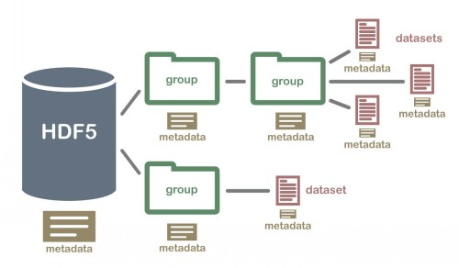
Folder/File Structure
Folders contain files and sub-folders
Files contain data
Metadata entries in text/json files
or in TIFF metadata fields
HDF5 Structure
Groups contain Datasets and/or groups
Datasets contain data
Group & Dataset Attributes contain metadata entries

Slide 12
dataFolder/
sessionA/
metadata.lfm (or lfmetadata.json, (.txt))
calib/
whiteImage.tif
darkImage.tif
calibration.lfc
raw/
<sample>.tif
deconv/
<sample>_deconv.tif
(if multipage-tiff)
/deconv
<sample>/
<sample>_deconv_<n>.tif
(if singlepage-tiff)

Slide 13
dataFolder/
sessionA/
metadata.lfm (or lfmetadata.json, (.txt))
calib/
whiteImage.tif
darkImage.tif
calibration.lfc
raw/
<sample>.tif
deconv/
<sample>_deconv.tif
(if multipage-tiff)
deconv/
<sample>/
<sample>_deconv_<n>.tif
(if singlepage-tiff)
Example with 2 samples
Session Folder:
/datafolder/sessionA
metadata.lfm
./calib
whiteImage.tif
darkImage.tif
calibration.lfc
./raw
sample_1.tif
sample_2.tif
(if writing a multipage stack:)
./deconv/
sample_1_deconv.tif
sample_2_deconv.tif
(if writing a series of tiffs as a stack, put in sub-folder)
./deconv/sample_1
sample1_deconv_1.tif
sample1_deconv_2.tif
...
sample2_deconv_1.tif
sample2_deconv_2.tif
...

Slide 14
Separate Metadata for Calib, Deconv ?
Different decovs with same calib but diff params
if there is no deconvMeta file in folder, implies use deconvMeta file in parent

Slide 15
Deep Learning: Training / Inferencing parameters
From LFMNet, VCD, …

Slide 16
<path>
<path>
Instrument/Acq
<SampleSet>
WhiteImage
Perspective
(subaperture)
metadata.lfm
(.json)
RawLFImage
DarkImage
Quick Stack
Calibration file
.lfc
Reference to
Stack

Slide 17
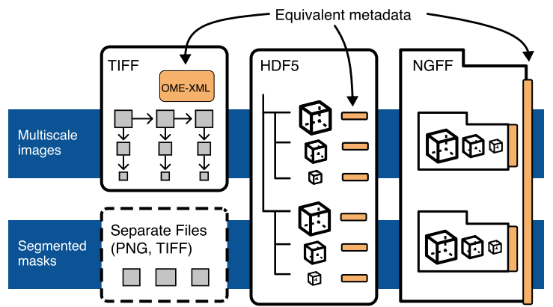
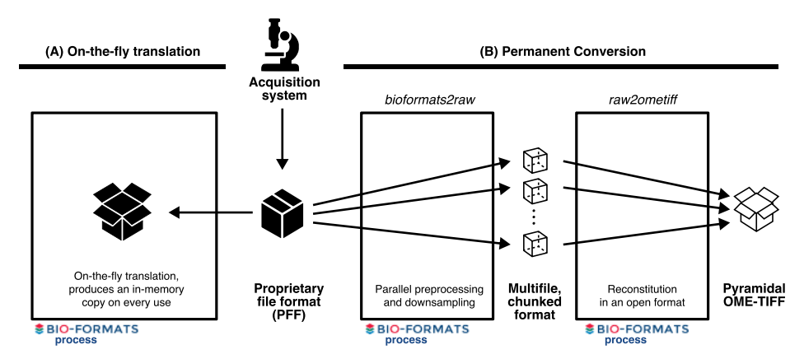
Data File Formats
OME-NGFF: a next-generation file format for expanding bioimaging data-access strategies

Slide 18
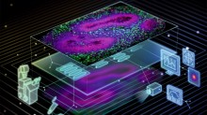
Microscopy Metadata
Essentially all of the parameters in LFAnalyze
Plus ?
Which of them pre-exist, i.e. are used in the bioimage community?
Bio-Formats
Micromanager
OME
Metadata -- Ontology
Quality Assessment and Reproducibility for Instruments & Images in Light Microscopy>>
WG 7 – Metadata>>
Caterina Strambio-De-Castillia at UMass Med Ctr
https://quarep.org/about/contact/
EDAM Bioimaging Ontology | NCBO BioPortal
Reporting and reproducibility in microscopy Nature Methods, 03 DECEMBER 2021

Slide 19
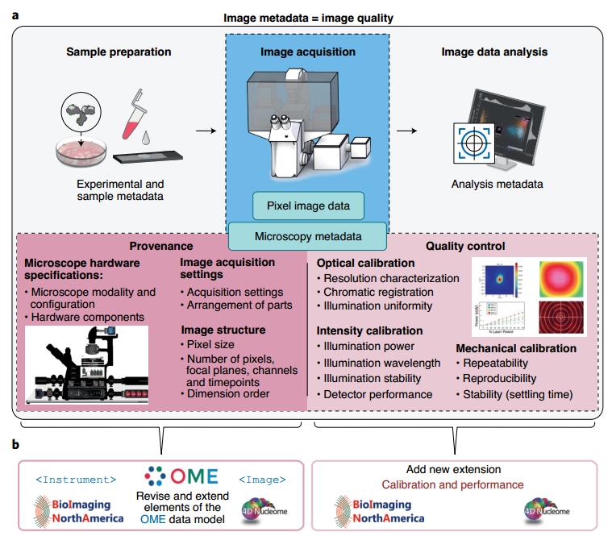
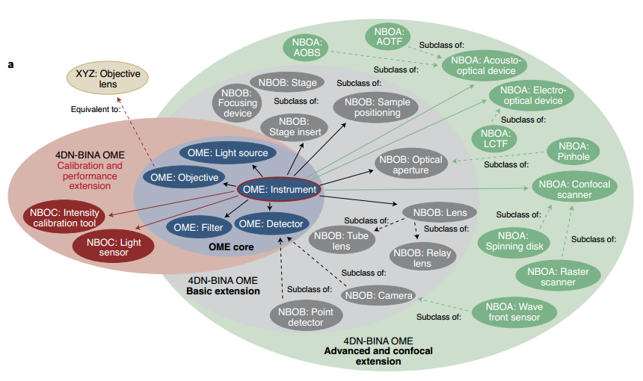
OME extended
Towards community-driven metadata standards for light microscopy: tiered specifcations extending the OME model

Slide 21
LFcalibrate
# Volume parameters
num-slices
um-per-slice
z-center
supersample
# Geometric calibration Options
affine-alignment
isometry-alignment
chief-ray
# Synthetic parameters
ns
nt
# Other Options
crop-center-lenslets
skip-alignment
skip-subpixel-alignment
num-threads
pinhole
lenslet
debug
# Parse command line options
output-filename
synthetic
use-ray-optics
voxels-as-points
# Calibration routine parameters
dark-frame
radiometry-frame
align-radiometry
# Optical parameters
pitch
pixel-size
focal-length
ulens-focal-distance
magnification
na
tubelens-focal-length
wavelength
medium-index
ulens-fill-factor
pixel-fill-factor
ulens-profile
Lfcalibrate, example:
python lfcalibrate.py
--radiometry-frame <raidometry.png>
--dark-frame <dark_frame.tif >
--pixel-size 4.55
--pitch 125
--focal-length 2433
--magnification 20
--na 0.5
--tubelens-focal-length 180.0
--wavelength 510
--medium-index 1.33
--num-slices 5
--um-per-slice 5.0
--supersample 4
--num-threads 10
-o <calibration.lfc>
Some values passed to LFDeconvole
Via . LightFieldCalibration
In __init__??

Slide 22
LFCalibration Report output
LF Calibration Report
ulens_focal_length (um)
ulens_focal_distance (um)
ulens_pitch (um)
ulens_profile
pixel_size (um)
objective_magnification
objective_na
medium_index
tubelens_focal_length
ulens_fill_factor
pixel_fill_factor
(nu,nv,ns,nt)
Geometry calibrated
Geometric calibration coefficients
forward:
reverse:
Geometric calibration for radiometry image, coefficients
forward:
reverse:
Radiometry calibrated:
Min, Max, Mean
Darkframe: T/F
Rayspread DB generated: T/F
number of z slices
spacing per z slices
z center
rayspreads in the database: #
light field psfs in the database: #

Slide 23
Calibration information is stored in an hdf5 file using attributes.
calibration_file.attrs['timestamp'] = str(datetime.datetime.now())
calibration_file.attrs['comments'] = '' # Empty for now...
# Optics
optics_group = calibration_file.create_group('optics')
optics_group.attrs['ulens_focal_length'] = self.ulens_focal_length
optics_group.attrs['ulens_focal_distance'] = self.ulens_focal_distance
optics_group.attrs['ulens_pitch'] = self.ulens_pitch
optics_group.attrs['pixel_size'] = self.pixel_size
optics_group.attrs['objective_magnification'] = self.objective_magnification
optics_group.attrs['objective_na'] = self.objective_na
optics_group.attrs['medium_index'] = self.medium_index
optics_group.attrs['tubelens_focal_length'] = self.tubelens_focal_length
optics_group.attrs['ulens_fill_factor'] = self.ulens_fill_factor
optics_group.attrs['pixel_fill_factor'] = self.pixel_fill_factor
optics_group.attrs['center_wavelength'] = self.center_wavelength
optics_group.attrs['ulens_profile'] = self.ulens_profile
# Geometric Calibration
if self.geometry_is_calibrated:
geometry_group = calibration_file.create_group('geometry')
geometry_group.attrs['calibration_image_filename'] = self.calibration_image_filename
geometry_group.attrs['skip_alignment'] = self.skip_alignment
geometry_group.attrs['alignment_method'] = self.alignment_method
geometry_group.attrs['nu'] = self.nu
geometry_group.attrs['nv'] = self.nv
geometry_group.attrs['ns'] = self.ns
geometry_group.attrs['nt'] = self.nt
# image warp models - the coefficient matrix.
if not self.skip_alignment:
geometry_group.create_dataset('forwardCoefficients', data = self.geometric_calibration_model.forwardCoefficients)
geometry_group.create_dataset('reverseCoefficients', data = self.geometric_calibration_model.reverseCoefficients)
# If a radiometry image was supplied, it will have its
# own geometry calibration. Otherwise is shares the
# default geometric calibration.
if self.radiometric_calibration_model is not None:
geometry_group.create_dataset('radiometryForwardCoefficients',
data = self.radiometric_calibration_model.forwardCoefficients)
geometry_group.create_dataset('radiometryReverseCoefficients',
data = self.radiometric_calibration_model.reverseCoefficients)
else:
geometry_group.create_dataset('radiometryForwardCoefficients',
data = self.geometric_calibration_model.forwardCoefficients)
geometry_group.create_dataset('radiometryReverseCoefficients',
data = self.geometric_calibration_model.reverseCoefficients)
if self.radiometry_is_calibrated:
radiometry_group = calibration_file.create_group('radiometry')
radiometry_group.create_dataset('radiometry', data = self.radiometry)
radiometry_group.create_dataset('radiometric_correction', data = self.radiometric_correction)
radiometry_group.create_dataset('rectified_radiometry', data = self.rectified_radiometry)
radiometry_group.attrs['has_dark_frame'] = self.has_dark_frame
if self.has_dark_frame:
radiometry_group.attrs['dark_frame_filename'] = self.dark_frame_filename
radiometry_group.create_dataset('dark_frame', data = self.dark_frame, compression = 'gzip')
# Rayspreads
if self.rayspread_db_generated:
print('Rayspread db generated')
rayspread_group = calibration_file.create_group('rayspread')
psf_group = calibration_file.create_group('psf')
# saving out the volume calibration data too
rayspread_group.attrs['num_z_slices'] = self.num_z_slices
rayspread_group.attrs['um_per_z_slice'] = self.um_per_z_slice
rayspread_group.attrs['z_center'] = self.z_center
# TODO: Pickling the rayspread_db is definitely the
# fastest way to save and load it for now, but it's
# brittle and opaque, and won't be backwards compatible if
# we ever change the rayspread_db class.
import pickle
if self.rayspread_db is not None:
rayspread_group.create_dataset('rayspread_db',
data = np.fromstring(pickle.dumps(self.rayspread_db),
dtype='uint8'),
compression = 'gzip')
if self.psf_db is not None:
psf_group.create_dataset('psf_db',
data = np.fromstring(pickle.dumps(self.psf_db), dtype='uint8'),
compression = 'gzip')
calibration_file.close()

Slide 24
Calibration File Structure
Optical parameters:
/timestamp
/calibration_image_filename
/dark_frame_filename
/comments
/optics/magnification [float - units: none]
focal_length [float - units: none]
na [float - units: none]
medium-index [float - units: none]
sample-index [float - units: none]
array-pitch [float - units: um]
Geometric Calibration
/geometric/geometric_calibration_type [string]
forward (or None) [3x2 numpy array]
backward (or None) [3x2 numpy array]
calibrated_nu [int]
calibrated_nv [int]
calibrated_ns [int]
calibrated_nt [int]
Radiometric Calibration
/radiometry/radiometric_calibration_type [string]
aperture (or None) [hex string -- serialized using numpy's tostring() and fromstring()]
Rayspread Database
/rayspread/rayspread_db [stored as pickled python object]
Perhaps not correct….

Slide 25
Rectify
output-pixels-per-lenslet
output-file
calibration-file
subaperture

Slide 26
Deconvolve
# Algorithm selection
solver
Approximate Message Passing (with optional multiscale denoising ('amp')
Alternating Direction Method of Multipliers with Huber loss ('admm_huber')
Alternating Direction Method of Multipliers with TV penalty ('admm_tv)
Conjugate Gradient ('cg')
Direct method with Cholesky factorization ('direct')
Least Squares QR ('lsqr')
K-space deconvolution ('kspace')
Simultaneous Iterative Reconstruction Technique ('sirt')
MRNSD ('mrnsd')
and Richardson-Lucy ('rl'). Default is currently 'sirt'.)
input_file
output-file
calibration-file
private-key
cov-directory
# Noise model parameters
readnoise-variance
background-level
# Algorithm-specific parameters
alpha
multiscale-smoothing
save-multiscale
# Assorted other parameters
disable-gpu
gpu-id
focalstack
remove-grid
pinhole-file
deconvolution-type
reg-factor
h5py-cov-filename
direct-type
benchmark
test
log-convergence
# Generic parameters for iterative reconstruction routines
lambda
lambda2
max-iter
convergence-threshold
Lfdeconvolve, example:
python lfdeconvolve.py
examples/ant_leg/light_field-000000.png
-c antleg_calibration.lfc
-o antleg_stack.tif

Slide 27
List of Issues…
LFI Plugin Design
HDF5 file structure and metadata
Start with LFMNet's HDF5 dataset file
GUI functions/details
Save the last state of the plugin, so that on the next startup the last dataset path is loaded along with the last parameters used. I'm sure napari should have some api for this already. See Persistence: https://napari.org/guides/preferences.html
Option to use the LF-Analyze folder option, to select one that is not included with the plugin. Currently that folder option has been disabled since I couldn't figure out a way to load the LF Analyze library from within the plugin.
Better progress indicator, however, this would need tweaking the LFA code to emit events.
https://napari.org/guides/event_loop.html
Add tooltips to existing GUI items
Annoyingly, to have a cascading menubar for the plugin it seems to need more than 1 widget, so have left the Example QWidget there as well for now. (defined in napari.yaml)
Good docs here: https://napari.org/guides/magicgui.html
Plugin layout design (separate widgets and/or tabs etc.) and User feedback regarding workflow
Articulate Use Cases/Workflow ... review with Rudolf
including:
Additional options that are included in script to be included in an additional tab as "Optional parameters".
Install / Config / Dependencies
Some message prompt to indicate about required libraries that are missing like opencv, h5py, etc. (these need to be installed into your napari env since they don't seem to install with napari)

Slide 28
More issues
Allow defining any property-tag in the LFvals file which will then be inherited by the GUI element (dont use generic names for non-GUI purposes to avoid conflicts).
Define a field 'metadata_tag' in LFvals (suggest doing this much later when HDF5 discussions have progressed and for now use 'dest' property-tag).
Ensure all properties have a 'label' field in LFvals and that they make 'sense'.
Intermediate/Final processed Image opening option(s)
LFDisplay's grid calibration routine
Remove Example Widget from menu but maintain the cascade style menu
Restructure calibrate, deconvolve, rectify properties in LFvals. Bunch common together. (suggest moving 'debug','benchmark', etc to a different section)
Add 'Reset to Defaults' for each panel and a global reset
Add comments and preset/profile field.
Better progress indicator.
HDF5 file structure and metadata
Add in-code documentation

Slide 29
GUI
Leveraging napari infrastructure…
GUI
MagicGUI
QtPy (abstraction layer over PyQT, PySide)
Leverage VizPy, Scikit-image, …
(Later…) Acquisition, camera control, drivers → Micromanager?

Slide 30
Input from LFAnalyse….

Slide 31
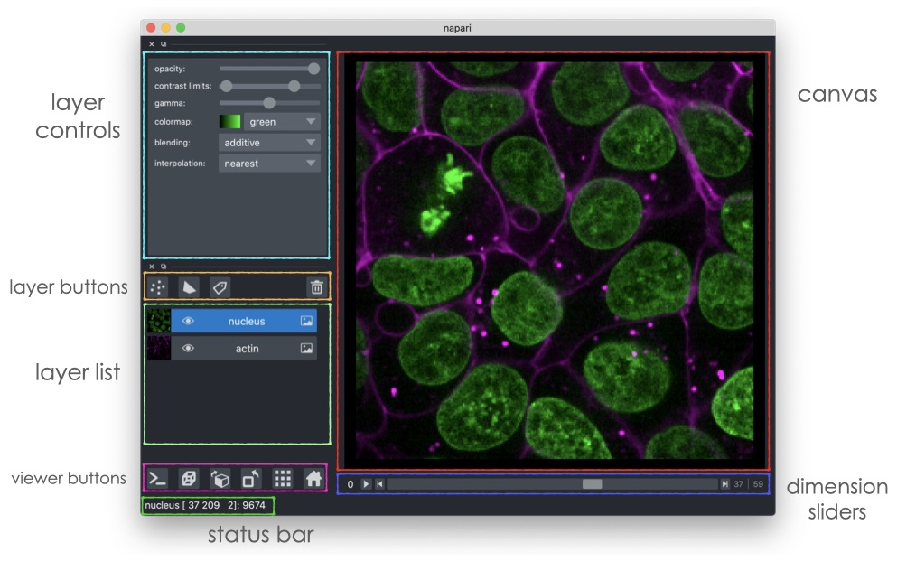
napariUI

Slide 32
LFDisplay

Slide 33
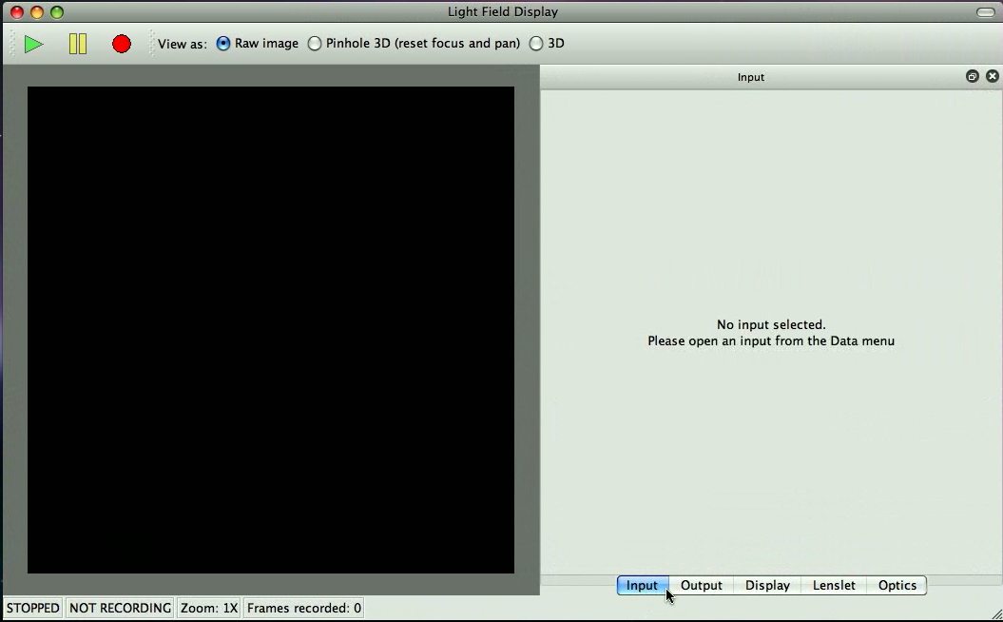

LFDisplay – Main window
Pinhole 3D: interactively explore a specimen

Slide 34
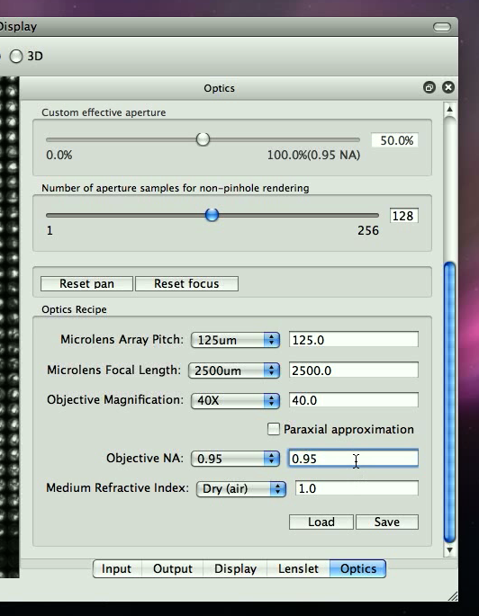
Optics [Config]

Slide 35
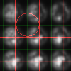
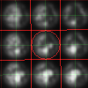
Lenslet –Manual Calibration
Click the ``Lenslet'' tab, click ``Show rectification'', and click ``Reset'' in order to begin manual rectification

Slide 36
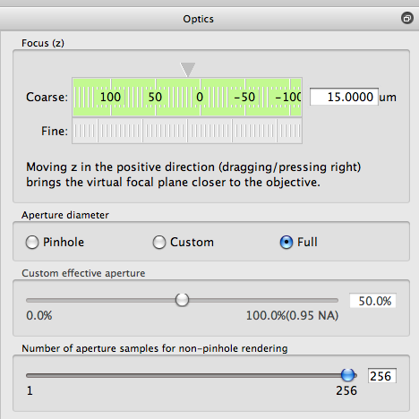
Optics [Explore]

Slide 37
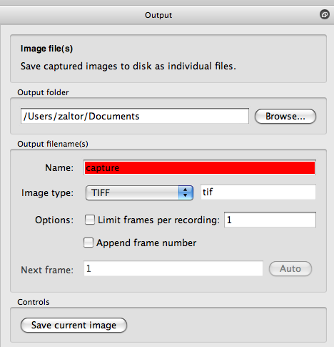
Output

Slide 38
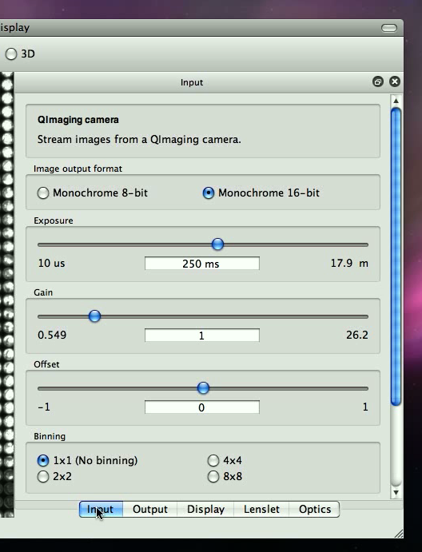
Input
Camera control
Acquisition

Slide 39
ImgNav…
Py version of ImgNav... in python?
add subdir organization and metadata/description/notes in file descibeme.
preview image. preview.tif [gif, jpg, png] with tiff [single|multiple page]]?
specify representative thumbnail
like a readme.

Slide 40
Templates
Text box with text resizing to fit
Instrument
THIS
THAT
Action
Action

